Slide 1
Telecom Churn Analysis EDA
Capstone Project - I
Presented By:
Aman Sharma
Mattaparty Harish
Pratik Thorat

Slide 2
Objective
Exploring and analyzing the data of Orange S.A., to discover key factors responsible for customer churn and come up with recommendations to ensure customer retention.

Slide 3
Introduction
Churn prediction is one of the most popular use cases in business. It consists of detecting customers who are likely to cancel a subscription to a service.
Churn is a problem for telecom companies because it is 5 times more expensive to acquire a new customer than to keep your existing one from leaving.

Slide 4
Timeline
1
2
3
4
Univariate Analysis
Bivariate Analysis
Multivariate Analysis
Business Suggestion

Slide 5
DATASET DESCRIPTION-
Source dataset is in csv format.
Dataset contains 3333 rows and 20 columns.
Columns has data in form of 16 Numeric Variables,3 Categorical variables & 1 Boolean Variable.
There is no missing values for the provided input dataset.
Only Churn column has Boolean values, which indicates weather the customer has churned or not.
All States are divided by three Area codes which are common.
The values in column international plan and voice mail plan are yes or no which can be considered as Boolean values for analytical purpose.

Slide 6
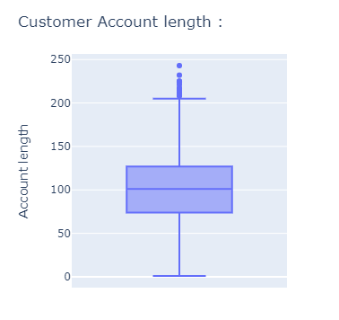
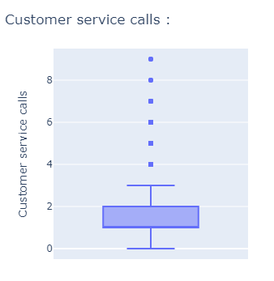
CHECKING FOR OUTLIERS-
Outliers related to customer account length is ignored by taking them as old customers as that can be a possible scenario.
Similarly outliers in customer service calls are ignored as there might be more number of calls due to poorer service.

Slide 7
DATA MANIPULATION-
Added a new column as customer id and values inserted in serial numbers from 1 to 3333, considering it as primary key.
Added a new column as "avg_calls_duration" which is average duration of total calls &"Call_duration" on the basis of duration of call, criteria for sorting is
Added a new column as "customer_type" on the basis of days of subscription, criteria for sorting is
We have created a copy of data frame and converted international plan and voice mail plans into Boolean values to find correlations.
Above 2.5, Long duration
In between 1.9 to 2.5, Medium duration
Below 1.9, Short duration
Above 120, old customer
In between 75 & 120, intermediate
Below 75, new

Slide 8
Univariate Analysis

Slide 9
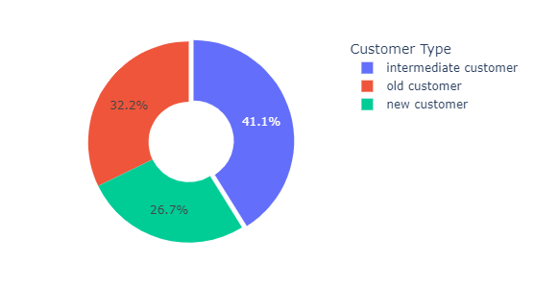
CUSTOMER DISTRIBUTION BY TYPE-
Insights Found:
Intermediate customers grab the greater chunk of customer distribution, followed by older customers.

Slide 10
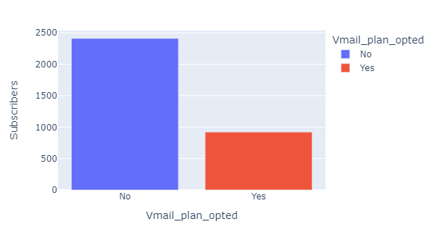
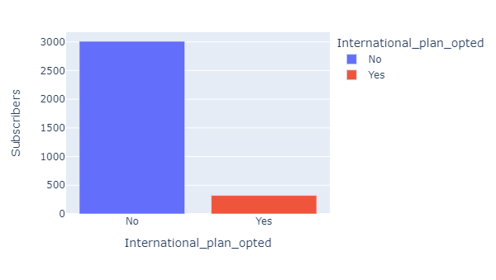
CUSTOMERS WHO OPTED FOR INTERNATIONAL PLAN OR VOICE PLAN-
Around 28% of the total customers opted for voice mail plans. So voice mail service is the most popular service opted by the customers.
Only around 10% of the total customers opted for International plan.

Slide 11
Bivariate Analysis

Slide 12
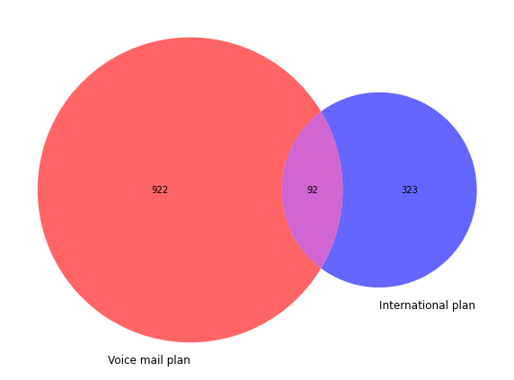
CUSTOMERS WHO SUBSCRIBED BOTH PLANS-
Insights Found:
The customers who subscribed both plans are 92.

Slide 13
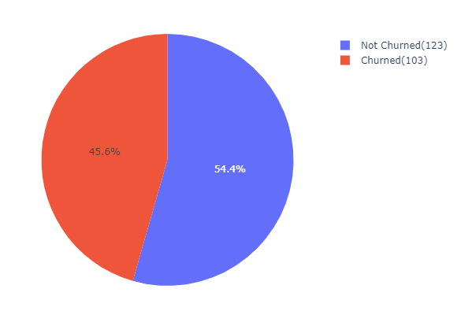
CHURN RATE AMONG INTERNATIONAL SUBSCRIBERS WITH LOWER CALL COUNTS-
Insights Found:
Customers who have made less than 6 international calls are most likely to churn.

Slide 14
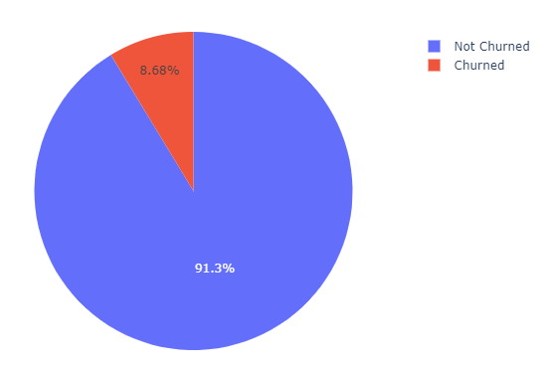
CHURN RATE AMONG VOICE MAIL PLAN SUBSCRIBERS WITH LOWER MAIL COUNT-
Insights Found:
The voice mail plan subscription has almost negligible effect on churn rate.

Slide 15
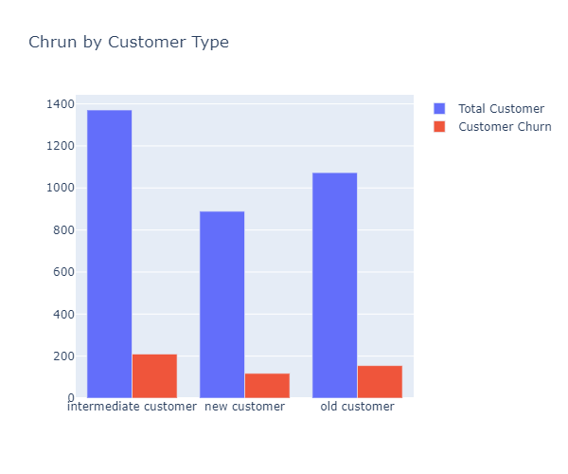
CHURN BY CUSTOMER TYPE-
Insights Found:
More percent of churns can be observed from the older & intermediate customers.

Slide 16
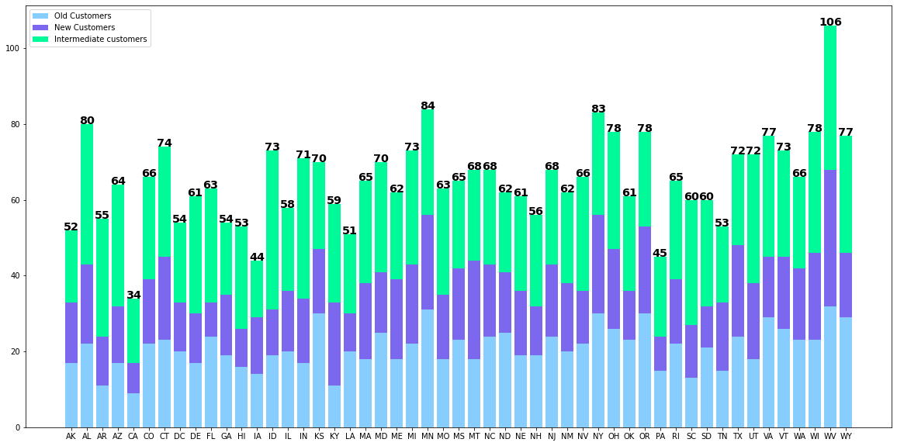
STATE WISE CUSTOMERS DISTRIBUTION-
Insights Found:
Out of 51 States, West Virginia, Minnesota, New jersey has maximum number of customers distribution respectively. West Virginia, Montana, New jersey has maximum number of new customer while states of West Virginia, Minnesota,Kansas has maximum number of old customers.

Slide 17
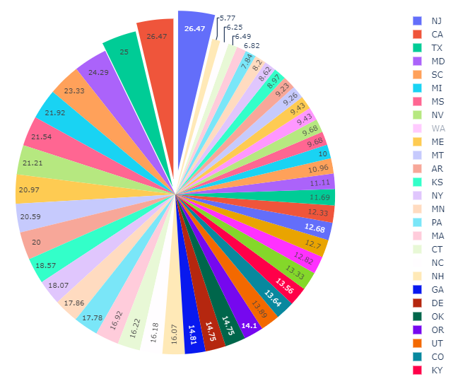
CUSTOMER CHURN BY STATES-
Insights Found:
Maximum percentage of churn rate can be observed from the states of New Jersey, California & Texas.

Slide 18
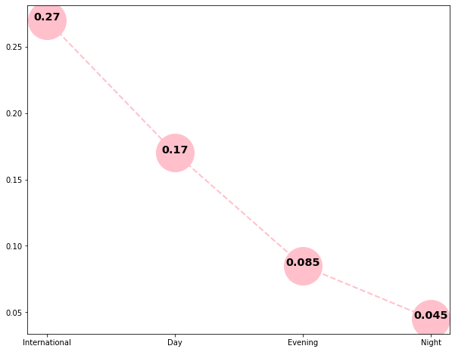
CHARGES PER MINUTES-
Insights Found:
Call charges are maximum for international calls and lowest for local night calls.

Slide 19
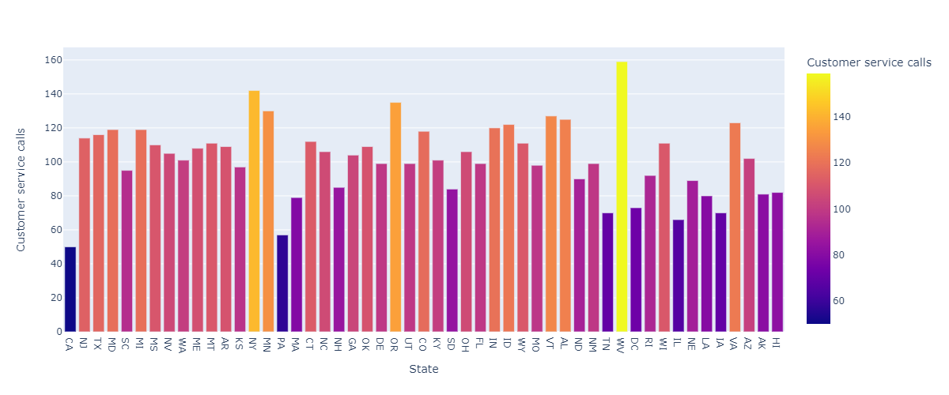
CUSTOMER SERVICE CALLS DISTRIBUTION-
Insights Found:
Maximum service calls are made from WV and NY but churn rate in WV is 9.43% and NY is 18.07%.

Slide 20
Multivariate Analysis

Slide 21
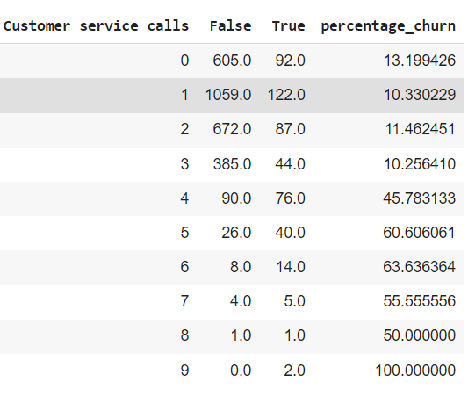
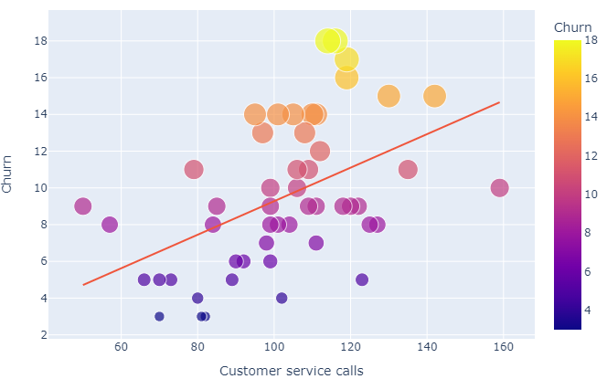
CORRELATION BETWEEN CHURN AND CUSTOMER SERVICE CALLS-
Insights Found:
Churn rate is positively corelated to number of customer service calls made. After number of calls cross 3 there is significant rise in churn percentage.

Slide 22
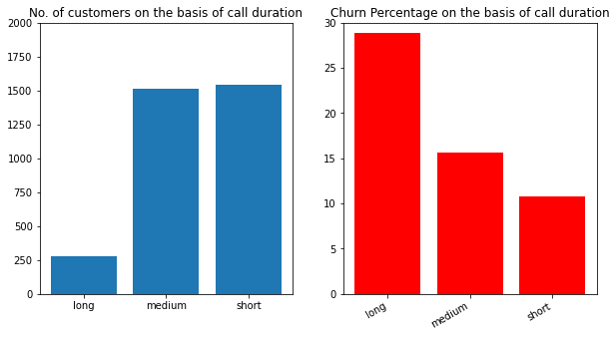
CHURN PERCENTAGE ON THE BASIS OF CALL
DURATION-
Insights Found:
It is evident that maximum churn percentage is in long duration calls.
Also service calls made by long duration callers is up to 3 calls which might be possible due to the reason that customer support that were unable to resolve their issues leading to higher churn rate.

Slide 23
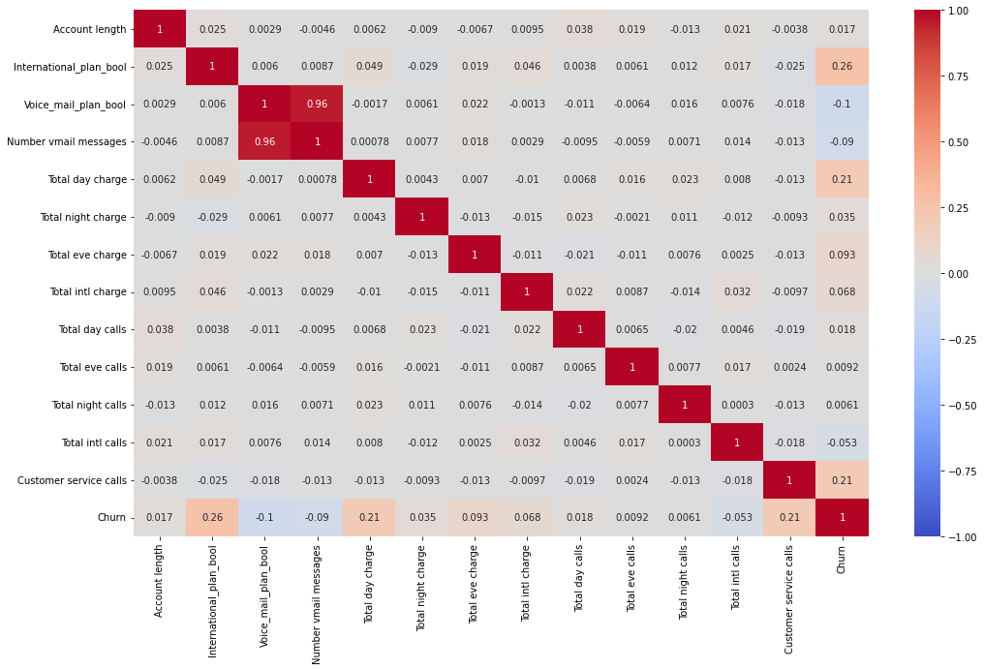
CORRELATION HEATMAP-

Slide 24
INSIGHTS FOUND FROM CORRELATION HEATMAP-
There is no major effect on churn with the number of voice mail subscribers.
There is positive correlation between
It seems that churn rate is correlated with international plans due to high charges associated with the service.
Similar issue can be assumed for high day call charges.
Churn rate and international plan opted.
Churn rate and total day charges.
Churn rate and customer service calls.

Slide 25
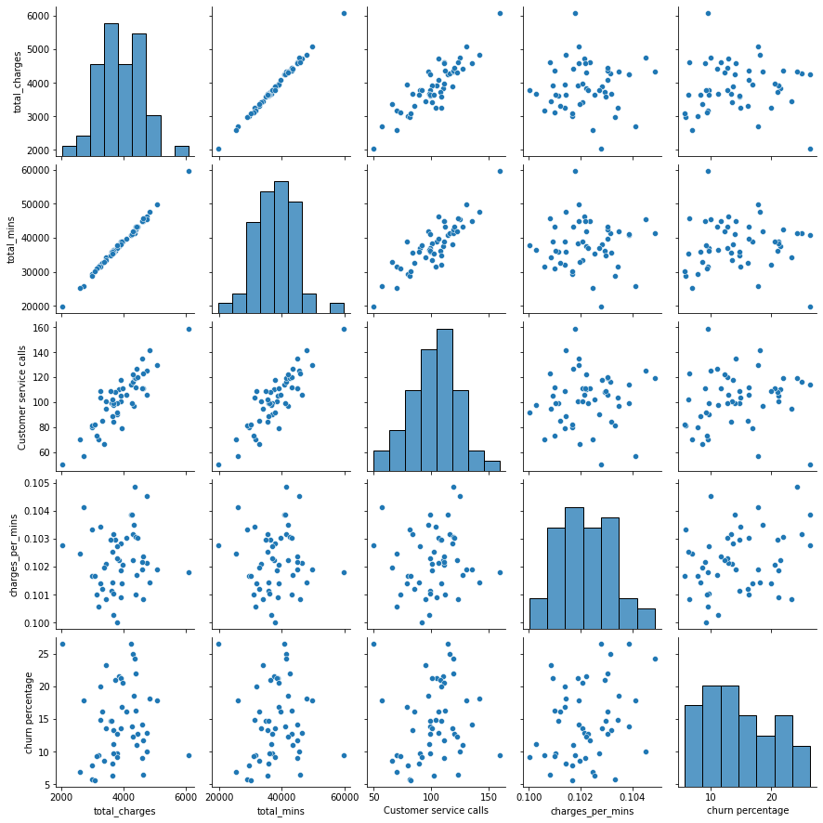
PAIR PLOT-
Insights Found:
There is positive correlation between total number of mins and number of service calls.
Also there is positive correlation of churn rate with customer service calls which might be due to the reason that customer support were unable to resolve customer issue.

Slide 26
SUGGESTIONS TO ACHIEVE BUSINESS OBJECTIVE-
Day charges are significantly higher than Night and Evening call charges which can be reason for higher churn rate, So it is suggested to reduce the day call charges and can consider providing happy hours kind of offer when there is least call traffic during the day.
Customers opting international plans are quite low (only 9.69%) so there is quite huge market to capture.
Only 28% percent of the customers have opted for voice mail plan which can be marketed further for increasing revenue.
Among the customers who have opted international plan & made lesser calls the churn rate is quite high (i.e. 45.58%), so it is suggested to provide better customer support & rebate on call tariffs for better retention as acquiring 5 times more costlier than retaining the old ones.
In few states the churn rate is quite high where more customer service calls were made. Maximum churn percentage is also observed in long duration calls & service calls made by long duration callers is up to three calls. Possible reason for this might be poor customer support.
In such state West Virginia customer support model can be adopted where the number of service calls were highest but churn has been comparatively lower.

Slide 27
LIMITATIONS IN ANALYSIS-
Limited dataset with similar distribution on call total charges and total call mins.
Weak correlation found between churn and some other variables.
RECOMMENDATION FOR ORANGE S.A. FOR FUTURE EDA-
Provide more data regarding customer like (age, sex), internet service, payment method, competitors information, congestion hours and other important factors from which we could draw more insights from the data.

Slide 28
Thank you

